Slide 1

HACK NAME: KISHAN MITRA
BY TEAM PURPLE

Slide 2
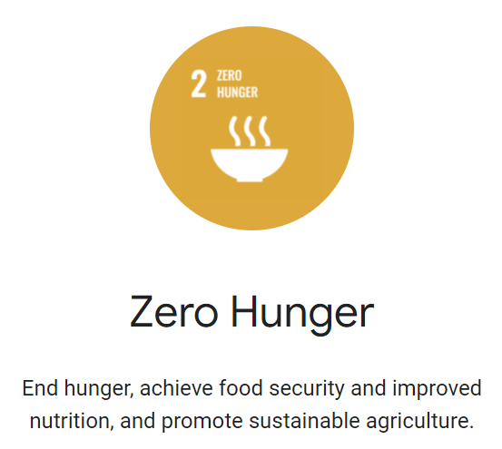
THEME

Slide 3
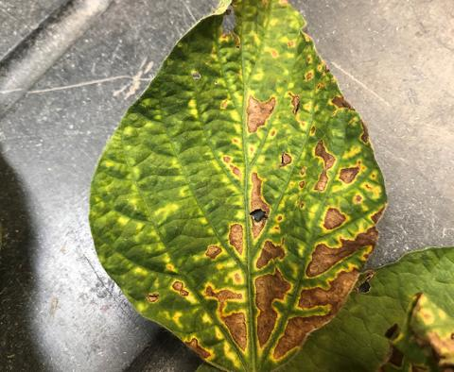
Problem Statement
Lack of knowledge and proper resources has always been a problem over all these years to our farmers. Not knowing what is best for the field, being totally unaware of what could happen in the future leads to thousands of acres of land going waste every year.
To tackle this problem of the farmer, my project specifically targets the crop prediction segment so as to make the farmer aware of what's best for the land he owns, and also give him approximate yield in advance itself based on parameters input.

Slide 4
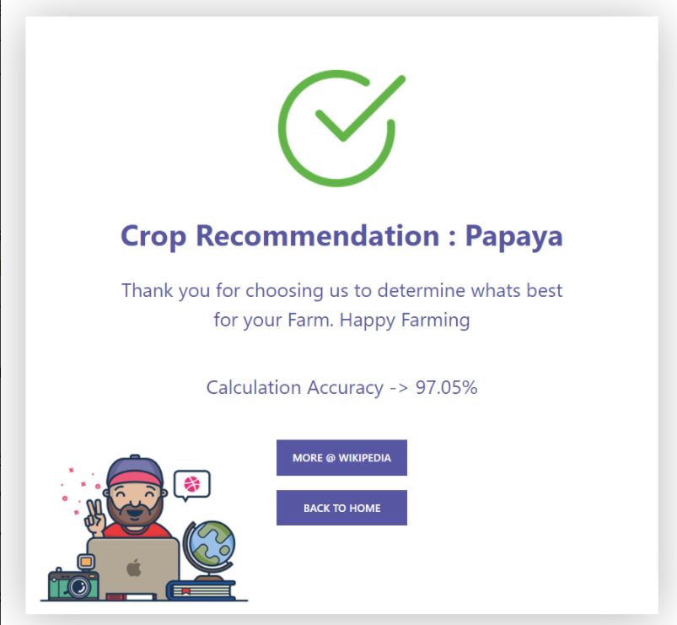
Tech Stack Used
Python
Django
Machine Learning
NGINX
Bootstrap
HTML / CSS

Slide 5



Solution
An open source datasets were collected from the internet required for training our models which can detect best crop to grow in any location.
Some pretrained models were also used during this process to reduce the time required for the development.
Once the ML was plotted, we have used Django to deploy our both ML part and backend together.

Slide 6

Future Scope
This feature can be integrated with IOT devices which can automatically takes temperature, location without even user's input and will tell the great accuracy what to grow and what not to grow.
With the help of this, we can improvise our model to even greater accuracy to prevent any farmer to make losses because of less scientific and researched knowledge.

Slide 7
Conclusion
Food security requires a multi-dimensional approach – from social protection to safeguard safe and nutritious food especially for children - to transforming food
systems to achieve a more inclusive and sustainable world.
So I think it will be the right to start increasing productivity from existing lands

Slide 8
Thank You!

